Slide 1
HRS4R Estrategia HRS4R y Plan de Acción del CSIC
1
#HRS4R

Slide 2
OBTENCIÓN DEL DISTINTIVO HRS4R
HRS4R
CARTA EUROPEA DEL INVESTIGADOR
Y
CÓDIGO DE CONDUCTA PARA LA CONTRATACIÓN DE INVESTIGADORES
OBTENCIÓN DEL DISTINTIVO
- Reputación
- Credibilidad
- Atractivo
CSIC
70 centros en España.
480 a nivel internacional (CNRS, LEIBNIZ, CERN…).

Slide 3
Human Resources Award
3
1
3
The European Charter for Researchers
OTM-R
A set of principles and requirements specifying the roles, responsibilities and rights of researchers as well as employers.
Open, Transparent and Merit-based Recruitment of Researchers
Article 32
Model Grant Agreement
Code of Conduct for their Recruitment
Work conditions,
Transparent and based merits recruitment processes,
Researchers career development.
Must ensure the and transparency of the recruitment process the equal treatment of all applicants.
2
4
#HRS4R

Slide 4
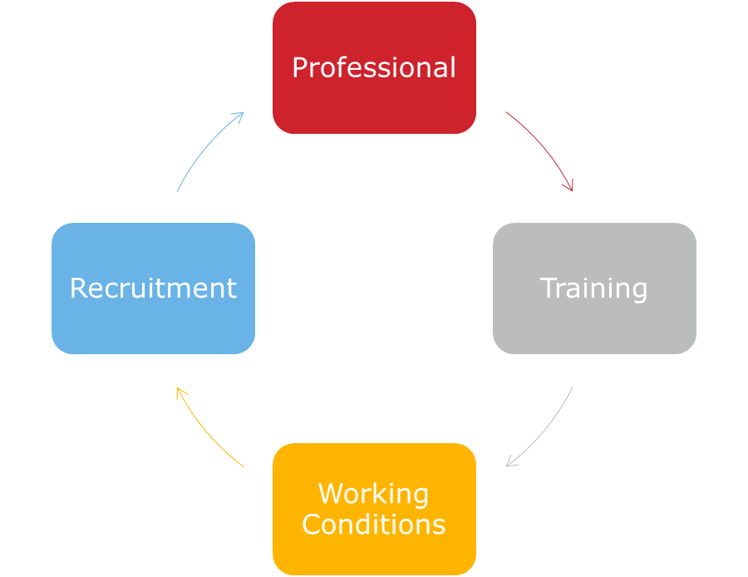
The Charter & Code
4
ETHICAL AND PROFESSIONAL ASPECTS | RECRUITMENT AND SELECTION | WORKING CONDITIONS AND SOCIAL SECURITY | TRAINING AND DEVELOPMENT
1. Research freedom 2. Ethical principles 3. Professional responsibility 4. Professional attitude 5. Contractual and legal obligations 6. Accountability 7. Good practice in research 8. Dissemination, exploitation of results 9. Public engagement 10. Non discrimination 11. Evaluation/ appraisal systems | 12. Recruitment 13. Recruitment (Code) 14. Selection (Code) 15. Transparency (Code) 16. Judging merit (Code) 17. Variations in the chronological order of CVs (Code) 18. Recognition of mobility experience (Code) 19. Recognition of qualifications (Code) 20. Seniority (Code) 21. Postdoctoral appointments (Code) | 22. Recognition of the profession 23. Research environment 24. Working conditions 25. Stability and permanence of employment 26. Funding and salaries 27. Gender balance 28. Career development 29. Value of mobility 30. Access to career advice 31. Intellectual Property Rights 32. Co-authorship 33. Teaching 34. Complains/ appeals 35. Participation in decision-making bodies | 36. Relation with supervisors 37. Supervision and managerial duties 38. Continuing Professional Development 39. Access to research training and continuous development 40. Supervision
#HRS4R

Slide 5
Plan Estratégico CSIC
2025
EECTI 2021-2027
ERA
PEICTI 2021-2023
RRHH en el CSIC
VITAE
Horizonte Europa
Actualización del C&C
“Talent management”
España 2050
Plan HRS4R
2021-2023
#HRS4R

Slide 6
HRS4R STRATEGY in a nutshell
6
HRS4R is the mechanism to implement the principles of C&C
Voluntary, structured and monitored procedure (continuous assessment)
Based on gap-analysis and action plan
gap analysis
action plan
online publication
#HRS4R

Slide 7
How to implement a successful HR strategy in the CSIC?
Top-down and bottom-up
Obtaining the support of CSIC's governing bodies
Involve our entire research community
Involve administrative units / management
#HRS4R

Slide 8
Appointment of the Working Groups
PRESIDENCY
Survey Researchers
(5.500)
Mini working groups
(R1, R2-R3 y R4)
SUPERVISOR
COMMITTEE
Working Group
(8 + 3) with a Representative Community of
Researchers and trade unions (12)
VICYT
VORI
First Stage Researcher (R1) (Up to the point of PhD)
Recognised Researcher (R2) (PhD holders or equivalent who are not yet fully independent).
R3 - Established Researcher (Researchers who have developed a level of independence).
R4 - Leading Researcher (Researchers leading their research area or field)
VRI
SEGE
#HRS4R

Slide 9
GAP Analysis
CSIC
Where are we?
C&C
1. Ethical aspects
2. Selection
3. Working conditions
4. Training
CSIC
Where do we want to go?
Implementation of the Charter & Code in our policies and practices
ACTION PLAN
(2021-2022)
Transform the “solutions”
Identify the "problems”
Actions
Deficiencies detected in GAP ANALYSIS and OTM-R
#HRS4R

Slide 10
Resultados Encuesta_HRS4R
Tasa de respuesta general:15%.
Por RI: 13%,
R2: 5%,
R3: 23%
R4: 59%.
Además, cada R señala como peor valorados:
RI: Participación en órganos decisorios.
R2: Nombramientos postdoctorales.
R3: Coincide con la tabla.
R4: Valor de la movilidad.

Slide 11
¿Dónde estamos ahora?
11
Marzo 2019
¡CONCEDIDO!
Encuesta Junio-Julio2019
Marzo2020
Agosto 2020
Reenvío Octubre2020
#HRS4R
Nos lo han concedido por lo que VAMOS A IMPLEMENTAR
¡NO por cómo estamos!

Slide 12
I. Principios éticos y profesionales
GAPS | ACCIONES
Comité de Ética | Difusión Formación Actualización de documentos
Antiplagio | Licenciar una herramienta antiplagio
Transferencia | Guía general Interacción investigador - empresas
Divulgación | Premio a la divulgación Criterio en la PCO Web propia
Evaluación/Seguimiento carrera investigador | Sistema de seguimiento

Slide 13
II. Selección y contratación
GAPS | ACCIONES
Transparencia en la contratación | Euraxess
Selección de funcionarios: tribunales | Bolsa de miembros de tribunales Recomendaciones C&C y HRS4R 1/3 tribunales designación aleatoria Formación
Selección de laborales | Nuevo portal de empleo Buenas prácticas Entrevistas personales Adenda a los contratos
Selección general | Informe a todos los candidatos Traducción al inglés OEP/Convocatorias

Slide 14
III. Condiciones laborales y Seguridad Social
GAPS | ACCIONES
Reconocimiento al personal investigador | Inclusión de RI, R2 y R3
Entorno investigador | Guía o catálogo de infraestructuras científicas Mantener el encuentro de investigadores
Información institucional | Encuesta bianuales sobre cond. laborales
Flexibilidad | Teletrabajo
Estabilidad y permanencia | CSIC Alumni, Interacción R1 y R2 – empresa Convocatoria para R2 y R3
Transparencia salarial | Actualización/publicación de tablas salariales
Docencia | Criterio en la PCO, Premio a la docencia, Marco regulatorio
Quejas del personal investigador | Defensor del investigador/alternativa
Asesoramiento sobre carrera profesional | Guía de apoyo
Movilidad | Convocatorias propias de movilidad Guía movilidad exterior
Participación en órganos decisorios | Asociación RI – R4 en consejo rector RI – R3 en claustros

Slide 15
IV. Formación y desarrollo profesional
GAPS | ACCIONES
Carrera profesional | Unidad de desarrollo de carrera profesional
Asesoramiento | Mentoring Buddy CSIC Alumni
Supervisión | Premio a la supervisión Formación

Slide 16
General Aspects
Actions / Sub-actions
A1 | HRS4R Kick-off and follow‐up
A2 | Implementation of a diffusion HRS4R campaign
A3 | Establishment of a working group to establish and completion a Welcome Manual and subsequent dissemination
A4 | Translate into English the documents to be determined by “Follow-up Working Group (FWG)”
A5 | Set up a working group to establish and conduct an analysis on C&C training needs
A6 | OTM-R Study, evaluation and development of an institutional policy in this area
A7 | Creation of the "HRS4R documents" repository in a specific area of the Intranet
#HRS4R

Slide 17
Ethical and Professional Aspects
Actions / Sub-actions
Ethical topics
A8 | Design of training courses online/on-site on ethical topics
A9 | Greater dissemination of everything related to the Ethics Committee (to be included in the Welcome Manual)
A10 | Completion of the update of the Scientific Good Practices.
A11 | General transfer guide
A12 | Support to the Open Science strategy
A13 | Create the CSIC’s Prize for Scientific Dissemination
A14 | Implementation of a monitoring system
A15 | “Promotable"
A16 | Promotion and improvement of the management of scientific projects: Undertake a set of structured actions to promote and improve project management
Non-discrimination
A17 | Promoting the integration of the gender dimension in research projects
A18 | Mention and recognition of the LGTBI collective
#HRS4R

Slide 18
Recruitment and Selection
Actions / Sub-actions
Increase visibility and transparency
A19 | Publication on EURAXESS Jobs Portal
A20 | Development of a Database of Expressions of Interest (BDEI)
A21 | Guide for candidates to civil servant research staff in the CSIC
Tribunals
A23 | Drafting of C&C and HRS4R recommendations for tribunals
A24 | Training for tribunal members
A25 | Propose and create a Working Group on Analysis and prospective in the Research Assessment in the CSIC
#HRS4R

Slide 19
Working conditions and Social Security
Actions / Sub-actions
A26 | Design and provision of an Attention Service for Research Staff
Recognizing the profession
A27 | Creation of a prize related to the novelty in research results and the impact and/or relevance in research
A28 | Creation of “The CSIC most relevant PhD Thesis Award”
A29 | Promote greater recognition of R1, R2, and R3 in the annual (Jun-Jul) research staff awards
Improve work conditions
A30. | Investment in basic infrastructures and centres
A31 | Conduct a survey on working conditions, including aspects related to: · Professional development. · Mental health and wellness. · Workplace and sexual harassment.
A32. | Implementation of a teleworking pilot programme
#HRS4R

Slide 20
Working conditions and Social Security
Actions / Sub-actions
Funding and salaries
A33 | Study the feasibility of a R1 and R2 call (FSE application + 2021-2027)
A34 | Submit launch proposal to the MSCA- COFUND programme
A35 | Study of a new option: indefinite contracts associated with a line of research
Improve stability and permanence of employment
A36 | Distinguished researchers’ figure: Study of the situation of the figure in the CSIC
A37 | Call for proposals to the extension of MSCA-IF contracts
A38. | Update and publication of the salary tables
#HRS4R

Slide 21
Working conditions and Social Security
Actions / Sub-actions
Increase support for mobility
A39 | To widen the scope of participants who can participate in own calls for mobility/internationalisation (I-link, I-coop)
A40 | Creation of a guide or web section on the external mobility of research staff
A41 | Dissemination/training info days on the possibilities of European and international programmes
A42. | Design and study the implementation of a common tool for the management of stay permits and mobility monitoring
Increase recognition and facilitate of teaching
A43 | New teaching management application. Identification, management and analysis of the teaching given by the Rs
A44 | Search for new formulas for the recognition of teaching
A45 | Creation of the "Mediator" figure
Enhance participation in decision-making bodies
A46 | Support and collaboration with the R1, R2 and R3 research association
A47 | At the ICU level, promote the presence of all research staff in the scientific boards
A48 | Maintain the meeting of researchers related to the new strategic plans
#HRS4R

Slide 22
Training and Development
Actions / Sub-actions
Design, advice and institutional support for professional development
A49 | Information
A50 | Training. Design training activities for professional development
A51 | Team management and leadership skills
A52 | Tracking of careers. Establish the career destinations of former researchers
A53 | Specific programme of R1-R2-company interaction
Providing advice and counsel
A54 | Launch of a Mentoring programme
A55 | Launch of a “Buddy” programme
A56 | Creation of "CSIC Alumni" (former CSIC "students")
Supervision and promote of its recognition
A57 | Creation of a "Margarita Salas Medal" award for best supervision
A58 | Training of PhD supervisors
#HRS4R

Slide 23
Situación del Plan de Acción HRS4R CSIC
23
Plan de Acción CSIC:
58 acciones ya definidas.
Vicepresidencias-Secretaría General-Gabinete de Presidencia
Alineamiento y ajuste al nuevo Plan Estratégico CSIC 2025
GRUPO DE SEGUIMIENTO HRS4R (FWG)
Se reúne semanalmente,
Revisa prioridades del CRONOGRAMA, analiza las acciones y posible orientación.
Cada integrante informa en su Unidad
GRUPO DE
SEGUIMIENTO HRS4R
UNIDADES IMPLEMENTADORAS
#HRS4R
COMITÉ SUPERVISOR

Slide 24
24
MUCHAS GRACIAS POR VUESTRA ATENCIÓN
#HRS4R

